Slide 1


Module 1:
Responsibilities of Board Members & Introduction to Local Government Commission
Revised March 2025

Slide 2


Responsibilities of Board Members
State and Local Government Finance Division
Members of a governing board have a fiduciary responsibility to the unit’s taxpayers and residents to manage funds and the unit appropriately.
The governing board is ultimately responsible for the finances and fiscal health of the unit.

Slide 3
Responsibilities of Board Members
State and Local Government Finance Division
Local governing boards are granted specific financial authorities and responsibilities in North Carolina General Statute 159, Article 3:
The Local Government Budget and Fiscal Control Act (LGBFCA). ^{[1]}

Slide 4
The Local Government Budget and Fiscal Control Act
State and Local Government Finance Division
The LGBFCA sets forth requirements for local governments in areas such as:
  Budgets
  Fiscal control
  Borrowing money
Members of governing boards should develop a strong working knowledge of the LGBFCA.
The act is just 35 pages and is available to read at ncleg.gov.
Key sections are covered in this training.

Slide 5

The Local Government Budget and Fiscal Control Act
State and Local Government Finance Division
Governing boards play a crucial role in overseeing a unit’s compliance with the LGBFCA.
Board members set expectations for employees to follow requirements of the LGBFCA.

Slide 6
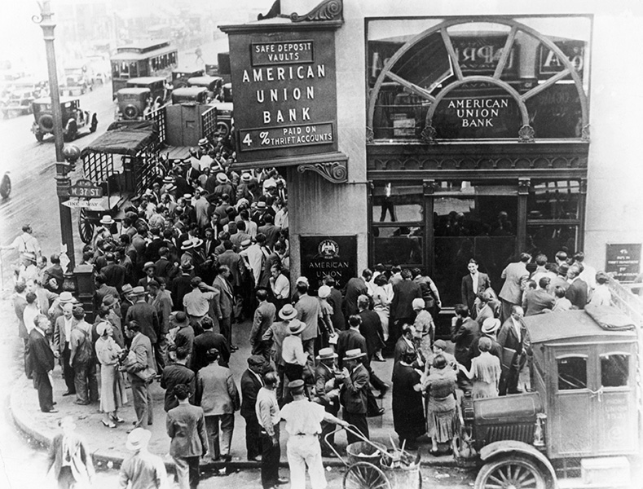
Local Government Commission (LGC)
State and Local Government Finance Division
Established in 1931 to address fiscal challenges faced by local governments during the Great Depression, the Local Government Commission (LGC)^{[2]} continues to provide financial oversight for more than 1,100 units of local government across the state, including 550+ municipalities and all 100 counties.

Slide 7
LGC Impact
State and Local Government Finance Division
“When state and local officials talk about best practices in financial oversight, they often point to North Carolina.”
The Pew Charitable Trusts, “State Strategies to Detect Local Fiscal Distress” (2016)
90+ years of LGC oversight has led to:
Above-average debt ratings for local governments.
“AAA” credit rating for the state from all three ratings agencies.
Lower cost of borrowing for North Carolina taxpayers.
Confidence in North Carolina’s debt market and the fiscal health of its local governments.

Slide 8

LGC Members
State and Local Government Finance Division
The LGC is composed of nine members.
State Treasurer, Brad Briner, serves as Chair.
Other members include the State Auditor, Secretary of Revenue, Secretary of State, and five appointed members.

Slide 9
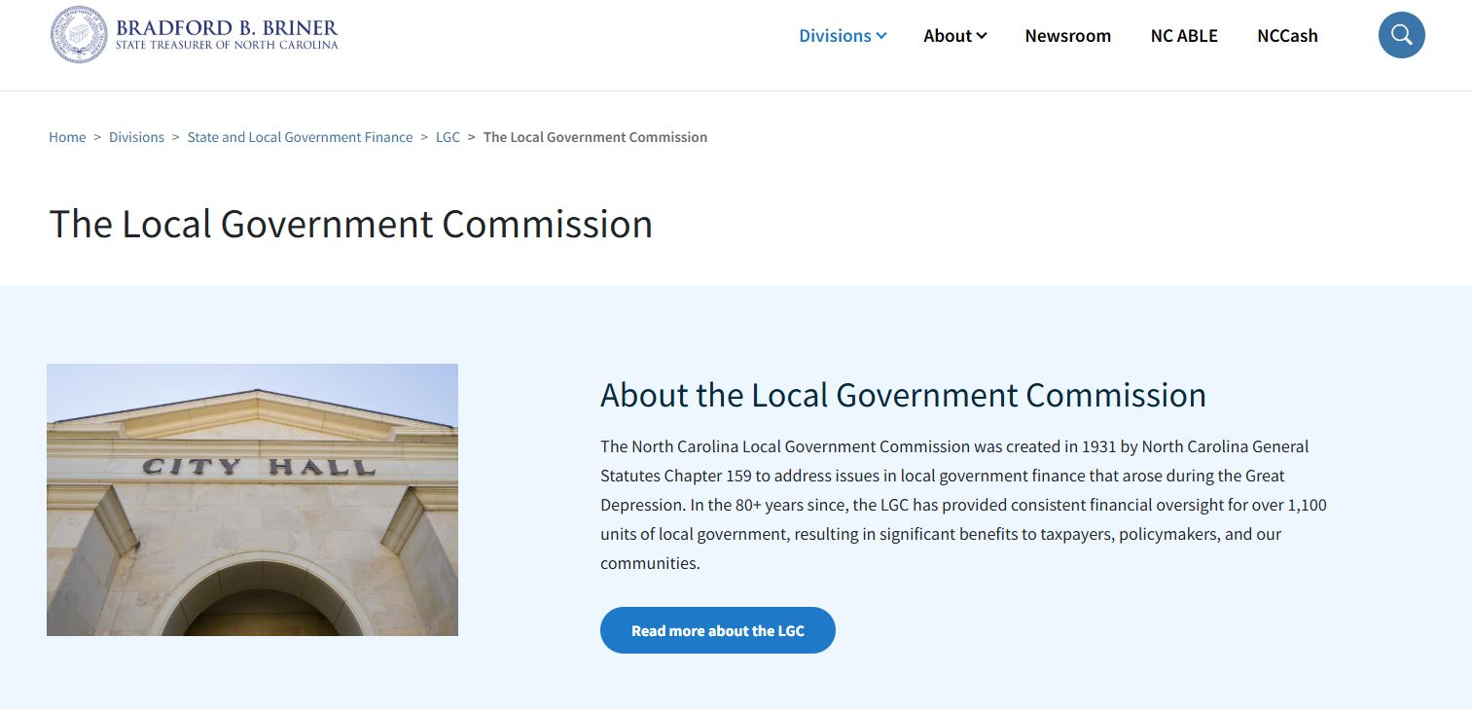
LGC Meetings
State and Local Government Finance Division
LGC meetings are held the first Tuesday of each month at 1:30 p.m.
Meetings can be live streamed from the LGC page on the Department of State Treasurer website.
The LGC page also contains links to meeting agendas and recordings of past meetings.

Slide 10
LGC Staff
State and Local Government Finance Division
LGC staff provide:
  Expert assistance to units as needed.
  In-person and virtual education/training for local officials.
  Up-to-date guidance on local government finance via memos and blog posts.
  Helpful information and resources on the LGC website.
The LGC is staffed by employees of the State and Local Government Finance Division (SLGFD) within the Department of State Treasurer (DST).
LGC staff work hard to assist the LGC and units of local government across the state.

Slide 11
Reporting Requirements and Due Dates for Local Governments
State and Local Government Finance Division
Units are required by law to regularly submit certain financial information to the LGC. This includes, but is not limited to:
Annual Audit^{[3]} – Due Dec. 31 for units with a June 30 fiscal year end
Annual Financial Information Report (AFIR)^{[4]} – Due Dec. 31
Semi-Annual Cash and Investment Report (LGC-203)^{[5]} – Due Jan. 25 and July 25
Register of Deeds Fees Report (Counties)^{[6]} – Due on the 10th of each month
Visit the LGC Reporting Requirements and Due Dates page for more information on these and other reporting deadlines.

Slide 12
Key Areas of LGC Authority for Local Governments
State and Local Government Finance Division
The Local Government Commission has authority under certain circumstances:
To require the finance officer or anyone performing the duties of the finance officer to participate in training.^{[7]}
To require local governments and public authorities to contract with outside entities, such as a third-party bookkeeper, to fulfill the duties of finance officer.^{[8]}
To impound the books and records of a local government and assume full control of all its financial affairs.^{[9]}

Slide 13

Resources
State and Local Government Finance Division
UNC School of Government
  NC Finance Connect
  Finance Calendar of Duties
  NC Local Government Finance 101
NC League of Municipalities
North Carolina Association of County Commissioners
Government Finance Officers Association - Best Practices & Resources
Contact LGC Staff: (919) 814-4300
Visit the LGC Website
Sign up for the LGC Staff Blog
Stay up to date with SLGFD Memos

Slide 14

Quiz: Module 1
State and Local Government Finance Division
Who is ultimately responsible for the finances and fiscal health of a unit?
Who is the Chair of the Local Government Commission?
Does the Local Government Commission have the authority to impound the books and records and assume full control of all financial affairs of a unit?

Slide 15
Module 2:
Budgets
Revised March 2025

Slide 16
Budget Overview
State and Local Government Finance Division
The budget is the most important fiscal document a governing board produces.
Developing a budget is a fundamental responsibility of a governing board.
The budget reflects the priorities of the governing board.
The Local Government Budget and Fiscal Control Act (LGBFCA) provides requirements for the development and adoption of a budget, including key dates.^{[1]}

Slide 17
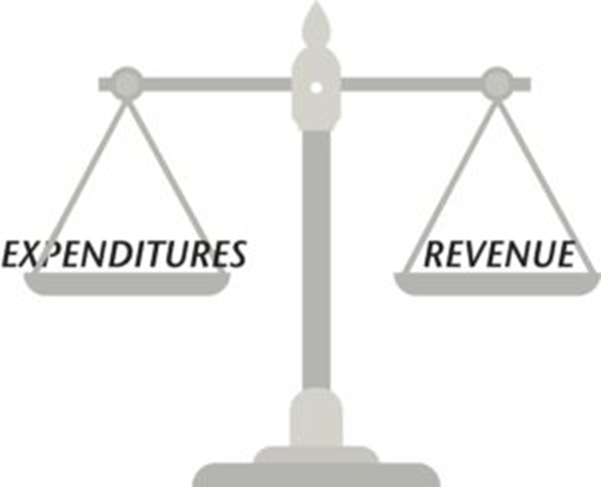
Budget Requirements
State and Local Government Finance Division
The budget for a local government must cover a period from July 1 to June 30.^{[2]}
  This is the unit’s fiscal year.
The budget must be balanced.^{[3]}
  Recurring revenues should equal recurring expenditures.
Fund balance should be reserved for special or unexpected circumstances.
  It should not be used to fund recurring expenditures such as payroll or utilities.

Slide 18
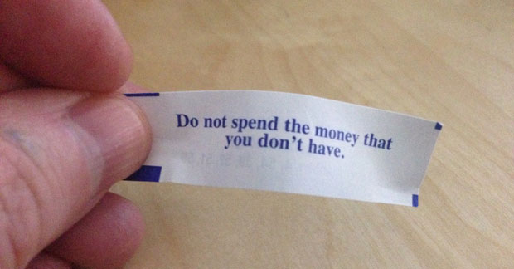
Budget Requirements
State and Local Government Finance Division
With limited exceptions, local governments may not spend any money that is not accounted for in the annual budget.^{[4]}

Slide 19
Budget Officer
State and Local Government Finance Division
Every local government must have a budget officer.^{[5]}
For units operating under a manager form of government, the manager is the budget officer.
  This includes all 100 North Carolina counties.
Municipalities not using the council-manager form of government may impose the duty of budget officer on any officer or employee, including the mayor.
The budget officer has two main duties:
Prepare the annual budget
Execute the annual budget

Slide 20

Governing Board Responsibilities
State and Local Government Finance Division
The governing board plays a key role in the budget preparation process by:
Establishing a solid timeline that allows the unit to consistently meet deadlines laid out in the LGBFCA.
Providing guidance, priorities, and goals to the budget officer.
  For example, a board may wish to allocate funds for staff raises, implement a new tax rate, etc.

Slide 21
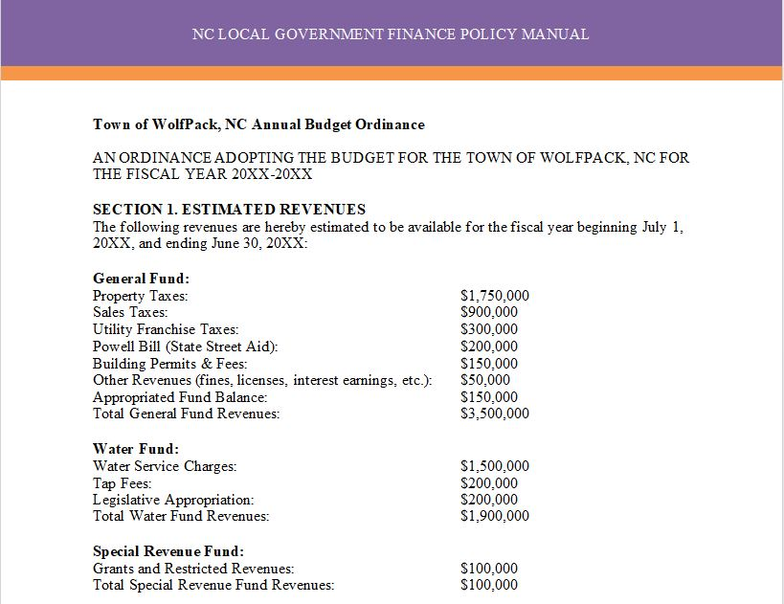
Budget Ordinance
State and Local Government Finance Division
The budget ordinance is the legal document that:^{[6]}
  Estimates operating revenues.
  Establishes authority to spend public monies via appropriations.
  Levies ad valorem taxes.
A budget ordinance should also include provisions for staff such as authority to transfer appropriations within a fund up to a certain limit.

Slide 22
Budget Ordinance
State and Local Government Finance Division
The budget ordinance must levy taxes “at rates that will produce the revenue necessary to balance appropriations and revenues.”^{[7]}
Therefore, the budget ordinance should include:
  Tax rate
  Valuation of taxable property
  Expected collection percentage
Units may not assume a higher tax collection percentage than what was actually realized during the last fiscal year.^{[8]}
“In other words, the budget may not be overly optimistic about how much of next year’s tax levy will result in actual dollars in the bank.”^{[9]}

Slide 23
Budget Adoption Timeline
State and Local Government Finance Division
January – April
The unit should hold budget workshops to discuss goals and priorities for the next budget.
The budget officer should estimate revenues and expenditures for the current and upcoming fiscal years.
Before April 30*
Department heads must submit budget requests and estimated revenues for their departments.^{[10]}
*Or earlier if required by the budget officer
By June 1
The budget officer must submit the proposed budget and budget message to the governing board.^{[11]}
Ideally, this submission should be part of a public meeting.
Upon submission
The budget officer must file the proposed budget with the board’s clerk on the same day it is submitted to the board.^{[12]}
The clerk must then make the budget available to the media/public and schedule a public hearing.
Before the budget is approved
The board must hold a public hearing at which those who wish to comment on the budget are allowed to speak.^{[13]}
By July 1
The board must adopt a budget ordinance.^{[14]}
At least 10 days must pass between submission of the budget to the governing board and adoption of the budget ordinance.
Within five days of adoption
Copies of the budget ordinance must be filed with the finance officer, budget officer and board’s clerk.^{[15]}

Slide 24
Interim Budget
State and Local Government Finance Division
If the budget ordinance cannot be adopted by July 1, an interim budget ordinance must be adopted.^{[16]}
Disbursements cannot be made after June 30 without an annual budget ordinance or interim budget ordinance.
Property taxes are not levied in an interim budget ordinance.
Interim budgets should be used rarely and for the shortest possible time.
When the final budget is adopted, the expenditures incurred under the interim budget must be included in the final budget.

Slide 25
Budget Amendments
State and Local Government Finance Division
The budget can be amended by the governing board at any time, as long as it remains balanced and continues to meet all other statutory requirements.^{[17]}
A budget amendment is adopted at a regular meeting and does not require a public hearing.
Budget amendments must be made prior to obligating funds in excess of budgeted appropriations.
An amendment to the budget ordinance may not alter the tax levy unless:
The board is directed to do so by a court or authorized state agency.
OR
Revenues received are substantially more or less than the amount estimated in budget. (In this case, the amendment may only be adopted before January 1.)

Slide 26
Fund Balance Available
State and Local Government Finance Division
Fund Balance Available or FBA is a governmental accounting term used only in North Carolina.
It is the portion of a unit’s total fund balance that can legally be used, if needed, to balance the annual budget.
FBA can be calculated from a unit’s annual audit using this spreadsheet provided by LGC staff.
Governments should develop a fund balance policy and adhere to it when taking budget actions.
Sample fund balance policies are available from NC Finance Connect.
Following a well-established fund balance policy can help units ensure that sufficient funds are available for special or unexpected circumstances.

Slide 27

FBA Targets
State and Local Government Finance Division
While there is no mandated minimum fund balance for units, the LGC uses established FBA thresholds as a measure of a unit’s financial health.
To learn more about the LGC’s FBA recommendations and determine a target that is appropriate for your unit, start by reading this blog post.
Annual reports on Management of Cash and Taxes and Fund Balance Available are available on the LGC website.

Slide 28

Creating Capital Reserves
State and Local Government Finance Division
The resolution or ordinance establishing the capital reserve fund must include:^{[18]}
The purposes for which the fund is created.
The approximate period of time during which the moneys are to be accumulated for each purpose.
The approximate amounts to be accumulated for each purpose.
The sources from which moneys for each purpose will be derived.
To save money for capital projects, such as new buildings or infrastructure improvements, governing boards can and should establish a capital reserve fund.

Slide 29


Using Capital Reserves
State and Local Government Finance Division
To make a withdrawal from a capital reserve fund, the governing board must pass a separate resolution or ordinance authorizing the specific withdrawal.^{[19]}
Withdrawals may only be authorized for purposes specified in the original resolution/ordinance establishing the fund or a purpose added in a subsequent amendment.

Slide 30
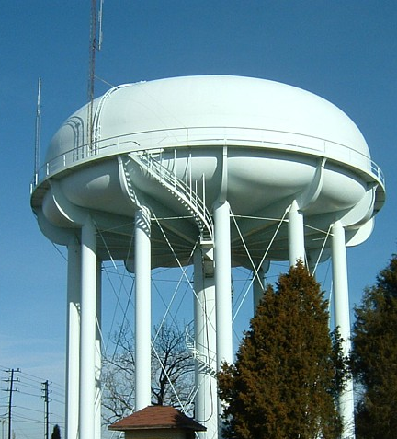
Other Considerations
State and Local Government Finance Division
Before transferring excess revenues from an enterprise fund to another fund, governing boards should:
  Understand the statutory limitations^{[20]} and potential consequences of such transfers.
  Carefully consider whether the specific transfer is in the best interest of the unit.
  Read this blog post for an in-depth discussion of this topic.

Slide 31
Other Considerations
State and Local Government Finance Division
For Example:
If the offices for a utility enterprise take up 20% of the square footage in city hall, then 20% of the upkeep expenses for city hall may be allocated to the enterprise fund.
If an operating expense serves/benefits multiple funds, it may be posted across those funds, using a reasonable allocation basis such as square footage.

Slide 32

Other Considerations
State and Local Government Finance Division
When developing a budget, governing boards should always try to think long-term.
Current budgeting priorities may impact the government for years to come.

Slide 33
Resources
State and Local Government Finance Division
Introduction to Local Government Budgeting (UNC School of Government)
N.C. Local Government Finance Policy Manual, Chapter 2: Budgeting (UNC School of Government)
N.C. Local Government Finance Policy Manual, Chapter 3: Fund Balance (UNC School of Government)
Sample Budget Ordinances (UNC School of Government)
Sample Adopted Budget (UNC School of Government)
Sample Budget Amendment
Fund Balance Available calculation
Sample Fund Balance Policies (UNC School of Government)

Slide 34
Resources
State and Local Government Finance Division
UNC School of Government
  NC Finance Connect
  Finance Calendar of Duties
  NC Local Government Finance 101
NC League of Municipalities
North Carolina Association of County Commissioners
Government Finance Officers Association - Best Practices & Resources
Contact LGC Staff: (919) 814-4300
Visit the LGC Website
Sign up for the LGC Staff Blog
Stay up to date with SLGFD Memos

Slide 35
Quiz: Module 2
State and Local Government Finance Division
What is the most important fiscal document a governing board produces?
Who is responsible for preparing and executing the annual budget?
By what date must the budget ordinance be adopted by the governing board?

Slide 36
Module 3:
Finance Officer & Monthly Financial Reports
Revised December 2025

Slide 37

Finance Officer
State and Local Government Finance Division
The Local Government Budget and Fiscal Control Act (LGBFCA) requires local governments to have a finance officer at all times.^{[1]}
The governing board should ensure a qualified person is in the role of finance officer.

Slide 38
Finance Officer: Powers and Duties
State and Local Government Finance Division
The finance officer is responsible under law for all of the following:^{[2]}
Keeping the unit’s accounts
Disbursing all funds
Preparing and filing financial reports
Receiving and depositing all moneys (or supervising receipts and deposits)
Monitoring and managing debt
Supervising investment of idle funds
Performing other duties assigned by law, manager, budget officer, governing board, or LGC rules and regulations
Attending training that may be required by the LGC^{[3]}
Contracting with outside entities to ensure fulfilment of duties

Slide 39
Finance Officer: Faithful Performance Bond
State and Local Government Finance Division
“The amount of the bond fixed by the governing board may not be less than the greater of the following:
Fifty thousand dollars ($50,000).
An amount equal to ten percent (10%) of the unit's annually budgeted funds, up to one million dollars ($1,000,000).”^{[7]}
To protect the local government from any losses caused by a finance officer who fails to properly carry out their duties, finance officers are required to obtain a faithful performance bond in an amount determined by the governing board in accordance with specific statutory requirements.
Note that these requirements have changed as of Jan. 1, 2023.^{[4][5][6]}

Slide 40
Contracted Third-Party Bookkeeper
State and Local Government Finance Division
When working with a third-party bookkeeper:
The board should continue to ensure a qualified finance officer is in place at all times.
The finance officer is still ultimately responsible for ensuring all duties are carried out in an accurate and timely manner.
The finance officer is empowered to contract with a third party for assistance with certain assigned duties.^{[8]}
Any work performed by a third-party bookkeeper should be closely supervised to ensure all contractual obligations to the unit are being met.
The third-party bookkeeper may be asked to attend board meetings to answer any questions the board might have.

Slide 41
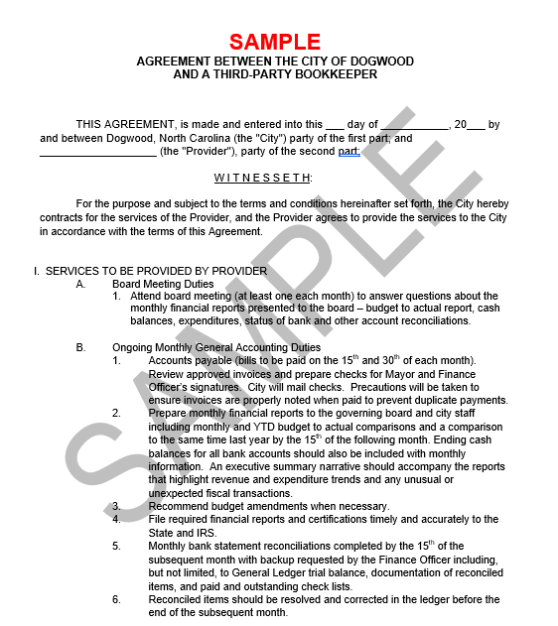
Contracted Third-Party Bookkeeper
State and Local Government Finance Division
Contract Considerations
Monthly financial reporting should be included in the contract.
The contract should also include specific language stating that the contractor will not be paid if the work outlined in the contract is not completed.
A sample contract for a third-party bookkeeper is available on the LGC website.

Slide 42
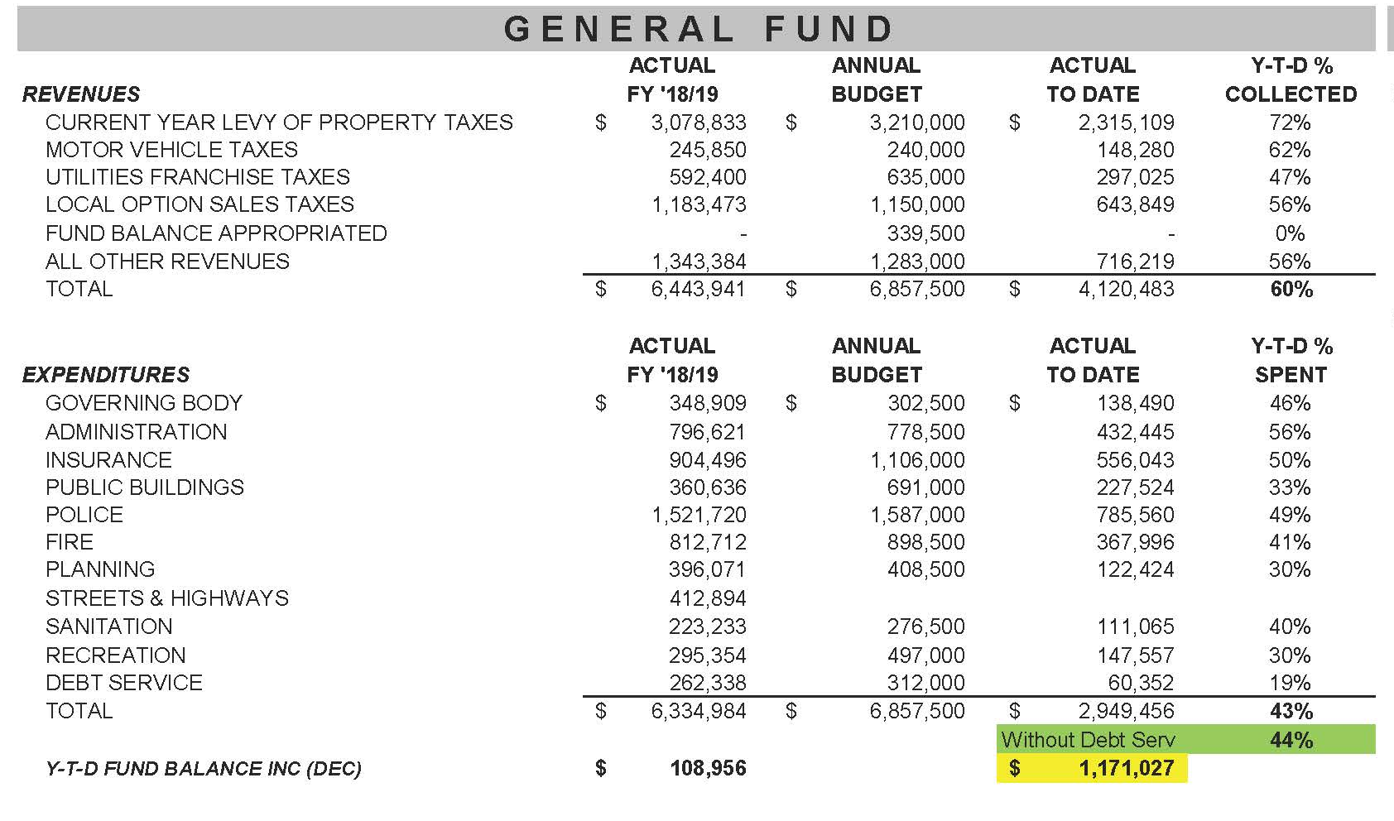
Monthly Financial Reports
State and Local Government Finance Division
Budget-to-actual reports for significant funds, including the general fund and utility funds
Governing boards should expect and require monthly financial reports.
Compared to prior year
Broken down by function or department

Slide 43

Monthly Financial Reports
State and Local Government Finance Division
Finance staff should explain any unusual transactions or amounts that are over/under performing against the budget.
Governing boards should always know the financial state of the unit.
Ask questions and follow up with the finance officer until you understand.
Download a financial summary template from the LGC website.

Slide 44

Monthly Financial Reports
State and Local Government Finance Division
Timely, accurate financial reports allow governing boards to:
Monitor the financial state of the unit and identify potential problems.
Ensure adequate reserves are maintained to address emergency needs.
Tailor budget amendments and future budgets to better match the needs of the unit.

Slide 45
Resources
State and Local Government Finance Division
North Carolina Government Finance Officers Association
  NC Finance Officers’ Certification Program
Sample Financial Summary
Sample Bookkeeper Contract
SLGFD Memo on Revised Fidelity Bond Requirements
UNC School of Government Local Finance Bulletin: Impending Changes to Bonding requirements for Finance Officers

Slide 46
Resources
State and Local Government Finance Division
UNC School of Government
  NC Finance Connect
  Finance Calendar of Duties
  NC Local Government Finance 101
NC League of Municipalities
North Carolina Association of County Commissioners
Government Finance Officers Association - Best Practices & Resources
Contact LGC Staff: (919) 814-4300
Visit the LGC Website
Sign up for the LGC Staff Blog
Stay up to date with SLGFD Memos

Slide 47
Quiz: Module 3
State and Local Government Finance Division
What is the amount for which the LGBFCA requires the finance officer to be bonded?
Who is responsible for preparing financial reports and supervising investments for the unit?
Who should always know the financial state of the unit?

Slide 48
Module 4:
Preaudits & Disbursements
Revised March 2025

Slide 49
What is a Preaudit?
State and Local Government Finance Division
Under North Carolina law:
“No obligation may be incurred in a program, function, or activity accounted for in a fund included in the budget ordinance unless the budget ordinance includes an appropriation authorizing the obligation and an unencumbered balance remains in the appropriation sufficient to pay in the current fiscal year the sums obligated by the transaction for the current fiscal year.”^{[1]}
When a local government preaudits an obligation, it is simply ensuring that these requirements have been met.

Slide 50
What is a Preaudit?
State and Local Government Finance Division
The finance officer is responsible for establishing procedures to ensure that the preaudit requirement is consistently met.^{[2]}
Specific language must be included on written agreements, such as contracts and purchase orders, certifying that the document has been preaudited as required by statute.^{[3]}
  This certificate must be signed by the finance officer or a deputy finance officer approved by the governing board.
  An exemption to the certificate requirement is provided for certain electronic payments. See slide 8.
In essence, a preaudit is the act of ensuring that for every financial obligation a unit makes:
Funds have been budgeted
Funds are actually available
A preaudit must be carried out before any obligation is incurred.

Slide 51

Why Preaudit?
State and Local Government Finance Division
Preaudits are a core component of effective fiscal management:
The preaudit requirement ensures that no obligation is incurred without sufficient funds in the budget.
By not spending money it does not have, a unit stands a better chance of staying within its budget throughout the fiscal year.

Slide 52
Fund Availability
State and Local Government Finance Division
For Example:
The city of Dogwood wants to spend $10,000 on new office furniture for the finance department during the current fiscal year.
Dogwood has $20,000 in the budget for furniture, but $15,000 has already been encumbered to purchase items for the city’s board room.
That means just $5,000 are only unencumbered funds, so Dogwood cannot incur the $10,000 obligation for the finance office furniture.
To fulfill the second component of the preaudit requirement, a unit must ensure that enough unencumbered funds are on hand to cover all costs associated with an obligation for the current fiscal year.
Unencumbered funds are distinct from total funds in the budget, which may include money which has already been encumbered (set aside) for other purposes.

Slide 53

Failure to Preaudit
State and Local Government Finance Division
If a unit fails to perform a preaudit for an obligation (contract, purchase order, etc.), that obligation is invalid and may not be enforced.^{[4]}
The finance officer can be held personally liable for payments made against an invalid obligation.^{[5]}

Slide 54
Disbursements
State and Local Government Finance Division
Disbursements of local government funds are governed by separate but similar statutory requirements to those for preauditing obligations.
The finance officer determines whether there are sufficient funds in the budget and the bank.
With limited exceptions^{[7]}, checks and claims must include a signed certificate attesting that the payment has been approved.^{[8]}
“When a bill, invoice, or other claim against a local government or public authority is presented, the finance officer shall either approve or disapprove the necessary disbursement.”^{[6]}

Slide 55
Automated Systems & Electronic Payments
State and Local Government Finance Division
Units are allowed to use an automated computer system to fulfill the preaudit requirement, as long as the system meets certain technical requirements.^{[9]}
If using such a system, the finance officer must file an annual certification with the LGC within 30 days of the start of the fiscal year.
The certification can be filed digitally on the LGC File Transfer Portal.
Under North Carolina Administrative Code, certain electronic payments can be made exempt from certificate requirements for preaudits and disbursements.^{[10][11]}
SLGFD Memo #2018-05 contains instructions related to this exemption.
Electronic payments must still be preaudited, even if a certificate is not required.

Slide 56

Setting Expectations
State and Local Government Finance Division
When crafting policies/procedures and communicating with staff, governing boards should:
  Set clear expectations that all preaudit and disbursement requirements will be followed.
  Emphasize that these processes are required by law and carry penalties for noncompliance.
  Support the finance officer when they must tell department heads that goods or services that are not budgeted cannot be purchased.

Slide 57
Resources
State and Local Government Finance Division
N.C. Local Government Finance Policy Manual, Chapter 12: Preaudits and Disbursements (UNC School of Government)
Sample Preaudit and Disbursement Policies (UNC School of Government)
Automated Systems and the Preaudit Requirement
  Preaudit System Certification
  Public list of verified certifications
SLGFD memo on certificate exemptions for electronic payments with sample resolution for local governments

Slide 58
Resources
State and Local Government Finance Division
UNC School of Government
  NC Finance Connect
  Finance Calendar of Duties
  NC Local Government Finance 101
NC League of Municipalities
North Carolina Association of County Commissioners
Government Finance Officers Association - Best Practices & Resources
Contact LGC Staff: (919) 814-4300
Visit the LGC Website
Sign up for the LGC Staff Blog
Stay up to date with SLGFD Memos

Slide 59
Quiz: Module 4
State and Local Government Finance Division
When must the preaudit function be performed?
What happens to a contract or purchase order if a unit fails to perform the preaudit?
What can the preaudit process help a local government avoid?

Slide 60
Module 5:
Annual Audit Process
Revised March 2025

Slide 61

Annual Audit
State and Local Government Finance Division
The Local Government Budget and Fiscal Control Act (LGBFCA) requires each local government and public authority to have an audit performed annually by an independent certified public accountant.^{[1]}
The auditor performs various audit procedures to examine the unit’s accounts.
Completed audits are submitted to LGC staff for review and made available to the public on the LGC website.

Slide 62

Audit Contracts
State and Local Government Finance Division
The governing board is responsible for selecting and entering into a contract with a qualified auditor.^{[2]}
It is a best practice to periodically issue a Request for Proposal (RFP) for audit services.
  Consider issuing an RFP every 3-5 years.
Audit contract forms, sample RFPs and other audit resources are available on the LGC website.
Audit contracts must include specific requirements^{[3]} and be approved by the LGC prior to any work starting.^{[4][5]}

Slide 63
When is LGC Approval Required?
State and Local Government Finance Division
The LGC does not approve:
Audits
  While the completed audit must be filed with and reviewed by the LGC, the LGC does not approve audits.
Auditors
  The LGC maintains a list of firms offering audit and non-audit services.
  This list is offered purely as a resource for local governments.
  Neither the LGC nor its staff recommend, endorse, or approve firms.
The LGC must approve:
Audit contracts (before work begins)
Audit invoices (before they are paid by the unit)^{[6]}

Slide 64

Modified and Unmodified Opinions
State and Local Government Finance Division
The auditor will give an opinion on whether the unit’s financial statements are presented in accordance with generally accepted accounting principles.
This can take one of two forms:
Unmodified opinion
Modified opinion

Slide 65
Modified and Unmodified Opinions
State and Local Government Finance Division
An unmodified opinion is issued when:
The auditor determines that a unit’s financial statements are presented fairly, meaning they provide a generally accurate picture of the unit’s finances.
There are no material misstatements – misstatements that could give a false impression of the unit’s financial position.
An unmodified opinion is not:
A finding that everything is 100% correct.
A guarantee there has been no fraud.
A statement that the unit did a good job with public funds.

Slide 66

Modified and Unmodified Opinions
State and Local Government Finance Division
A modified opinion is issued when:
The auditor determines that a unit’s financial statements contain material misstatements, which create a wrong or misleading picture of the unit’s finances.
  Material misstatements may include incorrect or missing information.
In most cases, LGC staff will not accept an audit with a modified opinion.

Slide 67

Assessment of Internal Controls
State and Local Government Finance Division
In addition to determining if financial statements are presented fairly, the auditor must also review the unit’s system of internal controls.^{[7]}
Internal controls are policies and procedures that a unit implements to protect assets and ensure accountability.
The auditor will provide a letter with findings and recommendations for improving internal controls.

Slide 68
Audit Deadline and Amended Contracts
State and Local Government Finance Division
Completed audits for fiscal years ending June 30, 2025, and later are due to the LGC six months after fiscal year end (December 31).
  See the LGC staff blog for more information on the new due date.
Amended contracts are required for any audits submitted on or after January 1.
  The amended contract must specify the revised date the unit plans to file its completed audit.
  There is no “grace period” for submission of amended contracts.
  Specific instructions and the contract amendment form are available on the LGC website.
Throughout the audit process, the governing board should:
Set expectations that the audit will be on time.
Ask for routine updates from staff about the status of the audit.

Slide 69

Auditor’s Presentation
State and Local Government Finance Division
No later than 45 days after filing the completed audit with the LGC, the auditor must make a presentation to the board at an official meeting in open session.^{[8]}
The governing board should come prepared and ask questions as needed.
Governing board members should have a strong understanding of the information being presented.

Slide 70
Auditor’s Presentation
State and Local Government Finance Division
The presentation will include:^{[9]}
A description of the auditor’s findings, including any issues related to the unit’s finances, internal controls, or compliance with applicable regulations.
An update on the status of the prior year’s audit findings.
Values of Financial Performance Indicators (calculated from the amounts reported in the financial statements).
Notification if the board must develop a “Response to the Auditor’s Findings, Recommendations, and Fiscal Matters” due to the presence of Financial Performance Indicators of Concern (FPICs) (defined on the following slides).

Slide 71

Financial Performance Indicators of Concern
State and Local Government Finance Division
The LGC developed a list of Financial Performance Indicators and defined specific “concern” levels.
Financial Performance Indicators of Concern or FPICs are defined as “Financial Performance Indicators with values which may indicate inadequate financial conditions or fiscal management concerns within the government unit.”^{[10]}
As of FY2021, the auditor is required to report FPICs to the governing board at the time the audit is presented.^{[11]}

Slide 72
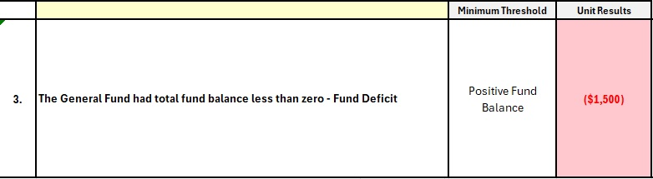
Financial Performance Indicators of Concern
State and Local Government Finance Division
Financial Performance Indicators are calculated by entering unit data into the Data Input Workbooks provided by LGC staff.
Once the necessary data is entered, values for each Financial Performance Indicator are calculated, and those that do not meet specified thresholds will turn red.
These red values in the Unit Results column are Financial Performance Indicators of Concern - FPICs.

Slide 73

Financial Performance Indicators of Concern
State and Local Government Finance Division
If FPICs are identified, the governing board must submit a response to the LGC describing in detail its plan to address and remedy each specific FPIC.^{[12]}
  Exceptions: If the auditor identifies only a lack of segregation of duties and/or a lack of expertise, and no additional FPICs are present, no response is required.

Slide 74
Financial Performance Indicators of Concern
State and Local Government Finance Division
Sample FPIC responses and related resources are available on the LGC website.
Completed responses should be uploaded to the LGC File Transfer Portal.
The LGC will review FPIC responses carefully to determine if the unit is taking appropriate action, with particular attention to repeated FPICs.
FPIC responses must be signed by a majority of the governing board and submitted to the LGC no later than 60 days after the audit is presented to the board or before the unit is included on the LGC agenda for debt approval.^{[13]}

Slide 75
Annual Audit Timeline
State and Local Government Finance Division
Start here
Select auditor and discuss terms
See audit contract form on LGC website
(Suggested timeframe: January – March)
Prior to start of audit work
Submit audit contract to LGC for approval
(Suggested Timeframe: March – April)
After contract is approved
Receive PBC (prepared by client) request list from auditor, preliminary audit work may begin
By Dec. 31
Audit work completed, audit submitted to LGC
*Any audit submitted on or after Jan. 1 requires an amended contract.
Within 45 days of audit submission
Audit presentation to governing board
Within 60 days of audit presentation
Governing board must submit any required FPIC responses to LGC

Slide 76
Resources
State and Local Government Finance Division
Audit Resources
Submitting Your Audit
LGC Staff Blog: FY2025 Audit Due Dates
Annual Audit Reports Submitted To LGC
Financial Performance Indicators of Concern
Financial Performance Indicators and Responses to the LGC
FPIC Sample Responses and Resources
SLGFD Memo #2023-04: How to Respond to Financial Performance Indicators of Concern (FPICs)

Slide 77
Resources
State and Local Government Finance Division
UNC School of Government
  NC Finance Connect
  Finance Calendar of Duties
  NC Local Government Finance 101
NC League of Municipalities
North Carolina Association of County Commissioners
Government Finance Officers Association - Best Practices & Resources
Contact LGC Staff: (919) 814-4300
Visit the LGC Website
Sign up for the LGC Staff Blog
Stay up to date with SLGFD Memos

Slide 78
Quiz: Module 5
State and Local Government Finance Division
How often does the LGBFCA require each local government to have an audit?
Who is responsible for selecting and entering into a contract with a qualified auditor?
Does the auditor have to present the findings of the audit to the governing board at a public meeting?

Slide 79
Module 6:
Internal Controls
Revised October 2025

Slide 80
Definitions
State and Local Government Finance Division
As defined by statute, an internal control is “an integral process, effected by an entity's governing body, management, and other personnel, designed to provide reasonable assurance regarding the achievement of objectives related to the effectiveness and efficiency of operations, reliability of financial reporting, and compliance with applicable laws and regulations.”^{[1]}
Put simply, “… internal controls help units achieve the things they want to happen, and … prevent unwanted events from occurring.”^{[2]}

Slide 81

Definitions
State and Local Government Finance Division
Three core objectives of internal controls for units of local government:
Reliability of financial reporting
Efficient and effective operations
Compliance with applicable laws and regulations

Slide 82


Definitions
State and Local Government Finance Division
Stewardship is the careful and responsible management of something that is entrusted into your care.
Governing boards have a stewardship responsibility to manage public money in a careful, responsible way.

Slide 83
Implementing Internal Controls
State and Local Government Finance Division
It is the responsibility of the governing board to ensure that internal controls are established and strictly adhered to.
Properly implemented internal control policies/procedures will help to:
  Protect assets
  Ensure accountability
  Guard against fraud, mistakes and other risks of loss
The board should work closely with the finance officer and other management personnel to maintain strong internal controls.
For information and guidance on internal controls, units can consult:
  SLGFD Memo #2026-04
  N.C. Local Government Finance Policy Manual, Chapter 9
  Sample policy documents at the end of this module

Slide 84

Implementing Internal Controls
State and Local Government Finance Division
Internal controls can and should be implemented for a wide variety of different functions and processes within a unit.
At a minimum, governing boards should ensure that strong written policies/procedures are in place for the following:
Credit cards and procurement cards (p-cards)
Petty cash
Bank and general ledger reconciliations
Cash receipts and deposits

Slide 85
Diagnosing Control Failures
State and Local Government Finance Division
Any of these may be warning signs of weak or failing internal controls:
Financial audits are missing or delayed.
Bank and other account reconciliations are delayed or inaccurate.
The board is not receiving timely and complete monthly financial statements.
Expenditures exceed authorized budget on a regular basis.

Slide 86

LGC Authority Over Internal Controls
State and Local Government Finance Division
Governing boards should be aware that the Local Government Commission (LGC) is empowered by statute^{[3]} to:
Issue rules and regulations governing units’ procedures for receiving, depositing, investing, transferring, and disbursing money or other assets.
Investigate the internal control procedures of a unit.
Require necessary or desirable modifications to a unit’s internal control procedures.

Slide 87
Resources
State and Local Government Finance Division
N.C. Local Government Finance Policy Manual, Chapter 9: Internal Controls (UNC School of Government)
The Internal Control Process (UNC School of Government)
Internal Control in Financial Management: Understanding the Basics (UNC School of Government)
SLGFD Memo #2026-04: Internal Controls for a Small Unit of Government
Internal Controls Over Petty Cash
Internal Controls Over Cash Receipts and Deposits
Internal Controls Over Inventory and Capital Assets
Sample Credit Card Policy
Sample Fleet Maintenance Policy

Slide 88
Resources
State and Local Government Finance Division
UNC School of Government
  NC Finance Connect
  Finance Calendar of Duties
  NC Local Government Finance 101
NC League of Municipalities
North Carolina Association of County Commissioners
Government Finance Officers Association - Best Practices & Resources
Contact LGC Staff: (919) 814-4300
Visit the LGC Website
Sign up for the LGC Staff Blog
Stay up to date with SLGFD Memos

Slide 89
Quiz: Module 6
State and Local Government Finance Division
What is the careful and responsible management of something that is entrusted into your care?
What are policies and procedures that help protect assets and ensure accountability?
What is one warning sign of internal control problems?

Slide 90
Module 7:
Establishing a Debt Policy
Revised March 2025

Slide 91
Using Debt
State and Local Government Finance Division
Debt is a tool that can be used to leverage available resources.
A mixture of debt and current resources may be used to finance projects.
Debt service must be included in the budget.^{[1]}

Slide 92

Debt Burden
State and Local Government Finance Division
Before issuing new debt, local governments should think about how it will affect their overall debt burden.
An unreasonable or heavy debt burden will limit future opportunities that a local government can take advantage of.

Slide 93

Debt Service Reminders
State and Local Government Finance Division
The LGC notifies local governments of debt service obligations for all debt approved by the LGC:
LGC 129s - Yearly notifications (sent by May 1) notifying units of total obligations for the coming fiscal year.^{[2]}
LGC 131s – Monthly notifications (sent at least 30 days before payment due dates) reminding units of upcoming principal and/or interest payments on outstanding obligations.^{[3]}
  Payments must then be reported to the LGC on provided forms.^{[4]}
Questions or concerns related to these reminders should be directed to:
LGC129@nctreasurer.com (annual notifications)
LGC131@nctreasurer.com (monthly notifications)

Slide 94

Establishing a Debt Policy
State and Local Government Finance Division
The governing board should establish a debt management policy.
A debt policy will help the government manage its finances and meet obligations.

Slide 95
Establishing a Debt Policy
State and Local Government Finance Division
A well written debt policy should include:
Uses of debt (When should debt be used?)
Types of debt permitted (What types of debt should be used in different situations?)
Debt limitation (How much debt should the unit take on?)
Debt repayment (When should debt be paid off and how should payments be structured over time?)
Refer to the sample debt policy on the LGC website as an example.

Slide 96
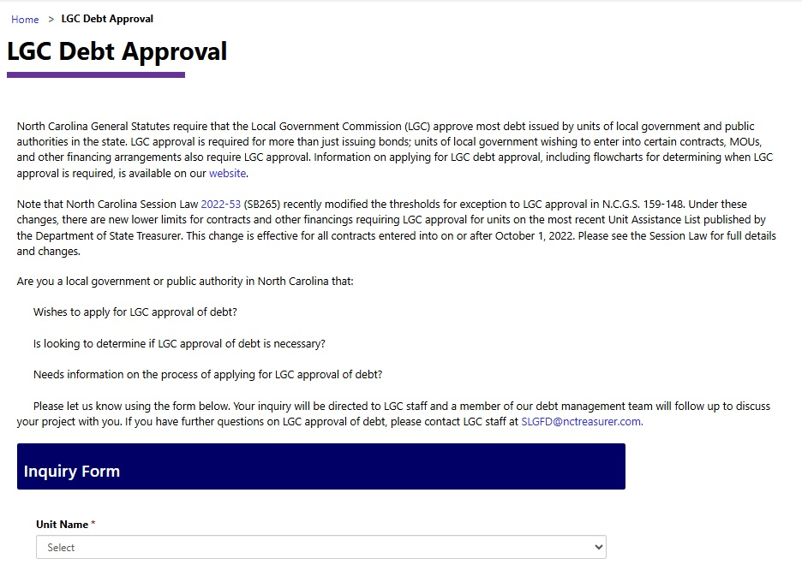
LGC Approval of Debt
State and Local Government Finance Division
Before issuing bonds^{[5]} or other types of debt^{[6]}, governing boards must submit a debt application to the LGC.
To determine whether LGC approval is required for a specific debt issuance:
Fill out a debt inquiry form with whatever information you can provide.
Consult the flow charts and other resources on the LGC website.
Reach out to LGC staff for guidance. We are happy to help determine if LGC approval is required.

Slide 97

LGC Approval of Debt
State and Local Government Finance Division
The LGC has adopted specific guidelines for the review and approval of debt applications.
Units with Financial Performance Indicators of Concern (FPICs) must submit any required FPIC responses before applying for debt.

Slide 98
Resources
State and Local Government Finance Division
Further reading:
LGC Approval of Bonds, Installment Financings, Leases, and Other Contracts Involving Capital Assets (UNC School of Government)
How Often Do Local General Obligation Bond Referenda Succeed in North Carolina? (UNC School of Government)
Debt Reports and Notices
Sample Debt Policy
Applying for Debt
Debt Inquiry Form
LGC Debt Approval Guidelines

Slide 99
Resources
State and Local Government Finance Division
UNC School of Government
  NC Finance Connect
  Finance Calendar of Duties
  NC Local Government Finance 101
NC League of Municipalities
North Carolina Association of County Commissioners
Government Finance Officers Association - Best Practices & Resources
Contact LGC Staff: (919) 814-4300
Visit the LGC Website
Sign up for the LGC Staff Blog
Stay up to date with SLGFD Memos

Slide 100
Quiz: Module 7
State and Local Government Finance Division
What is a tool that can be used to leverage available resources?
Does debt service have to be included in the budget?
What is one thing a good debt policy should include?

Slide 101
Module 8:
Ethics & Conflicts of Interest
Revised December 2025

Slide 102
Disclaimer
State and Local Government Finance Division
Please note that neither the Local Government Commission (LGC) nor the State and Local Government Finance Division (SLGFD) play any role in implementing, enforcing, or interpreting North Carolina ethics laws and guidelines applicable to local elected officials.
This brief module is provided purely to inform local governing board members of their basic responsibilities in the areas of ethics and conflicts of interest. It is not meant to be an exhaustive guide, an authoritative source, or legal advice.
Please see the resources at the end of the module for additional information, and contact the appropriate organization or authority for guidance related to specific questions/concerns.

Slide 103


Ethics Requirements for Local Governing Boards
State and Local Government Finance Division
North Carolina law requires all governing boards to:
  Adopt a code of ethics.^{[1]}
  Receive at least two hours of ethics training within 12 months of being elected or reelected to office.^{[2]}
Elected officials set the tone for the organization by carefully adhering to standards of ethical behavior, avoiding impropriety in the exercise of official duties.

Slide 104

Principles of Ethical Conduct
State and Local Government Finance Division
Honesty and Integrity - Board members should foster public trust in the board among the community by acting responsibly and transparently.
Impartiality and Respect - All issues and all citizens should be handled with fairness, impartiality and respect.

Slide 105

Principles of Ethical Conduct
State and Local Government Finance Division
Fair and Equitable Treatment - Board members should never act in a way that would result in unfair or preferential treatment.
Effort - Board members have an obligation to faithfully perform their duties.
Accountability - Board members should accept responsibility for upholding their code of ethics.

Slide 106

Conflicts of Interest
State and Local Government Finance Division
A conflict of interest is a situation in which a person stands to receive a personal benefit from actions or decisions they make in an official capacity.
Public officials may not, for example:
  Receive direct benefits from public contracts that they are involved in making or administering.^{[3]}
  Use non-public information for personal financial gain.^{[4]}
Governing boards should understand and comply with state restrictions on accepting gifts or favors from contractors and suppliers.^{[5]}
These are just a few examples of restricted conduct. See the resources on the next slide for more information, and remember to participate in required ethics training.

Slide 107
Resources
State and Local Government Finance Division
Ethics for Local Government Officials (UNC School of Government)
County and Municipal Government in North Carolina, Chapter 7: Ethics and Conflicts of Interest (UNC School of Government)
Ethics for Elected Officials training course (UNC School of Government)
Ethics & Conflicts blog posts (UNC School of Government)

Slide 108
Resources
State and Local Government Finance Division
UNC School of Government
  NC Finance Connect
  Finance Calendar of Duties
  NC Local Government Finance 101
NC League of Municipalities
North Carolina Association of County Commissioners
Government Finance Officers Association - Best Practices & Resources
Contact LGC Staff: (919) 814-4300
Visit the LGC Website
Sign up for the LGC Staff Blog
Stay up to date with SLGFD Memos

Slide 109
Quiz: Module 8
State and Local Government Finance Division
Chapter 160A of North Carolina law requires all locally elected officials to receive a minimum of two hours of ethics training within how many months of being elected or reelected?
What is a situation called in which a person stands to receive a personal benefit from actions or decisions they make in an official capacity?
What kind of information should public officials avoid using for their own financial gain?

