Slide 1


Module 3:
Finance Officer & Monthly Financial Reports
Revised December 2025

Slide 2


Finance Officer
State and Local Government Finance Division
The Local Government Budget and Fiscal Control Act (LGBFCA) requires local governments to have a finance officer at all times.^{[1]}
The governing board should ensure a qualified person is in the role of finance officer.

Slide 3
Finance Officer: Powers and Duties
State and Local Government Finance Division
The finance officer is responsible under law for all of the following:^{[2]}
Keeping the unit’s accounts
Disbursing all funds
Preparing and filing financial reports
Receiving and depositing all moneys (or supervising receipts and deposits)
Monitoring and managing debt
Supervising investment of idle funds
Performing other duties assigned by law, manager, budget officer, governing board, or LGC rules and regulations
Attending training that may be required by the LGC^{[3]}
Contracting with outside entities to ensure fulfilment of duties

Slide 4
Finance Officer: Faithful Performance Bond
State and Local Government Finance Division
“The amount of the bond fixed by the governing board may not be less than the greater of the following:
Fifty thousand dollars ($50,000).
An amount equal to ten percent (10%) of the unit's annually budgeted funds, up to one million dollars ($1,000,000).”^{[7]}
To protect the local government from any losses caused by a finance officer who fails to properly carry out their duties, finance officers are required to obtain a faithful performance bond in an amount determined by the governing board in accordance with specific statutory requirements.
Note that these requirements have changed as of Jan. 1, 2023.^{[4][5][6]}

Slide 5
Contracted Third-Party Bookkeeper
State and Local Government Finance Division
When working with a third-party bookkeeper:
The board should continue to ensure a qualified finance officer is in place at all times.
The finance officer is still ultimately responsible for ensuring all duties are carried out in an accurate and timely manner.
The finance officer is empowered to contract with a third party for assistance with certain assigned duties.^{[8]}
Any work performed by a third-party bookkeeper should be closely supervised to ensure all contractual obligations to the unit are being met.
The third-party bookkeeper may be asked to attend board meetings to answer any questions the board might have.

Slide 6
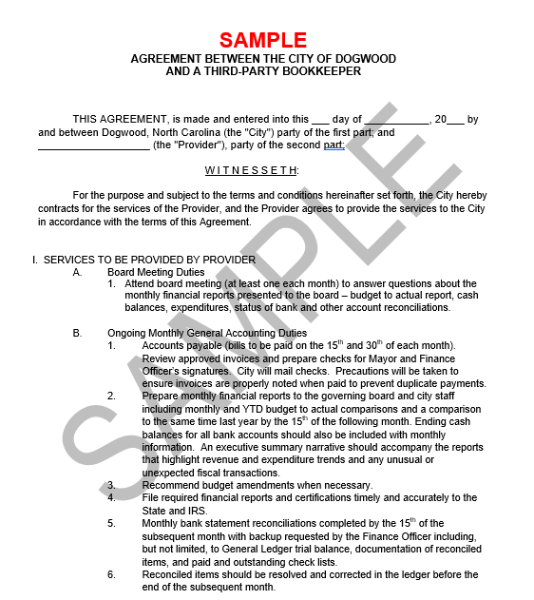
Contracted Third-Party Bookkeeper
State and Local Government Finance Division
Contract Considerations
Monthly financial reporting should be included in the contract.
The contract should also include specific language stating that the contractor will not be paid if the work outlined in the contract is not completed.
A sample contract for a third-party bookkeeper is available on the LGC website.

Slide 7
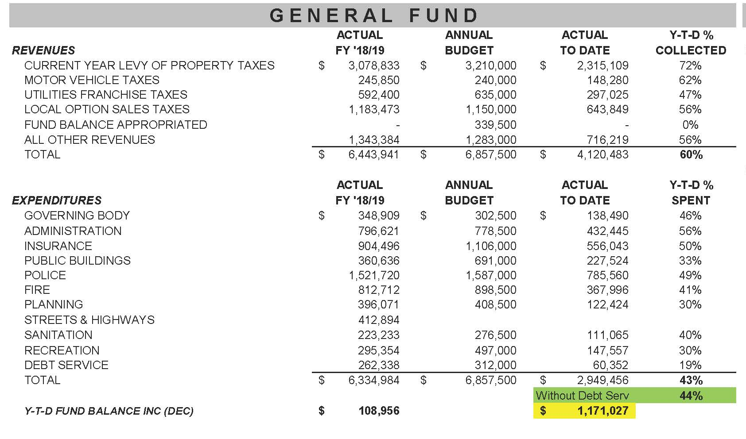
Monthly Financial Reports
State and Local Government Finance Division
Budget-to-actual reports for significant funds, including the general fund and utility funds
Governing boards should expect and require monthly financial reports.
Compared to prior year
Broken down by function or department

Slide 8

Monthly Financial Reports
State and Local Government Finance Division
Finance staff should explain any unusual transactions or amounts that are over/under performing against the budget.
Governing boards should always know the financial state of the unit.
Ask questions and follow up with the finance officer until you understand.
Download a financial summary template from the LGC website.

Slide 9

Monthly Financial Reports
State and Local Government Finance Division
Timely, accurate financial reports allow governing boards to:
Monitor the financial state of the unit and identify potential problems.
Ensure adequate reserves are maintained to address emergency needs.
Tailor budget amendments and future budgets to better match the needs of the unit.

Slide 10
Resources
State and Local Government Finance Division
North Carolina Government Finance Officers Association
  NC Finance Officers’ Certification Program
Sample Financial Summary
Sample Bookkeeper Contract
SLGFD Memo on Revised Fidelity Bond Requirements
UNC School of Government Local Finance Bulletin: Impending Changes to Bonding requirements for Finance Officers

Slide 11

Resources
State and Local Government Finance Division
UNC School of Government
  NC Finance Connect
  Finance Calendar of Duties
  NC Local Government Finance 101
NC League of Municipalities
North Carolina Association of County Commissioners
Government Finance Officers Association - Best Practices & Resources
Contact LGC Staff: (919) 814-4300
Visit the LGC Website
Sign up for the LGC Staff Blog
Stay up to date with SLGFD Memos

Slide 12

Quiz: Module 3
State and Local Government Finance Division
What is the amount for which the LGBFCA requires the finance officer to be bonded?
Who is responsible for preparing financial reports and supervising investments for the unit?
Who should always know the financial state of the unit?

